Slide 1
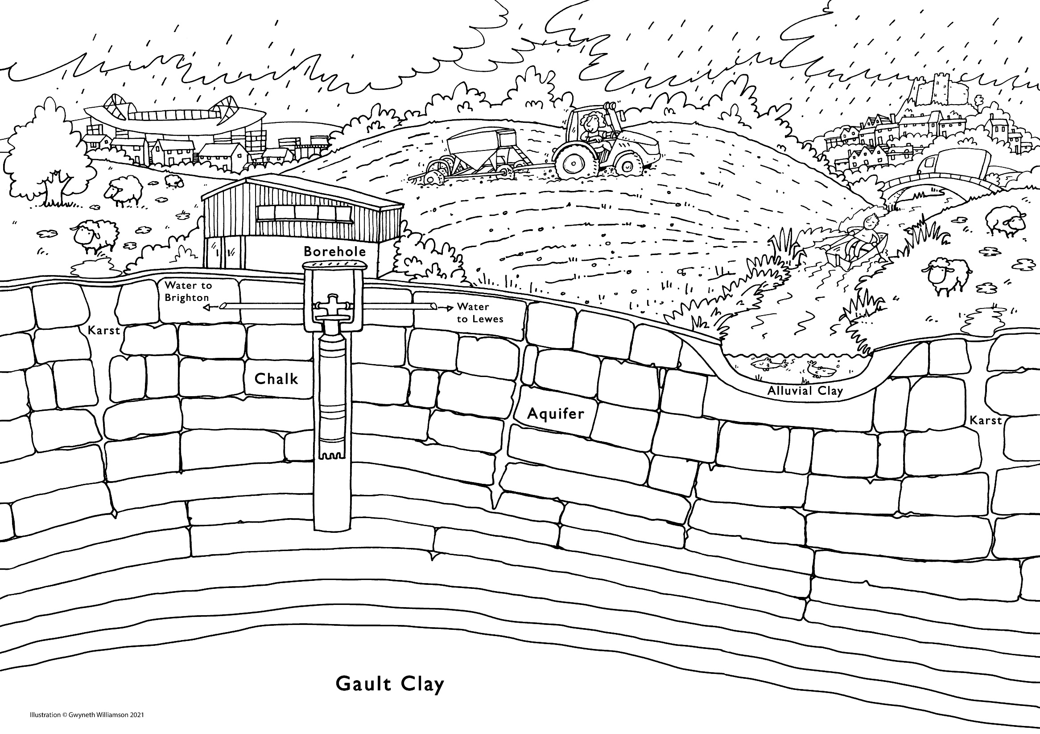
Groundwater provides drinking water for everyone living in and around Brighton and Lewes.
In the south east 70% of people receive water from an underground aquifer.
Colour in some groundwater that can be pumped from this borehole!
Find out more – visit wearetap.org.uk

